Slide 1
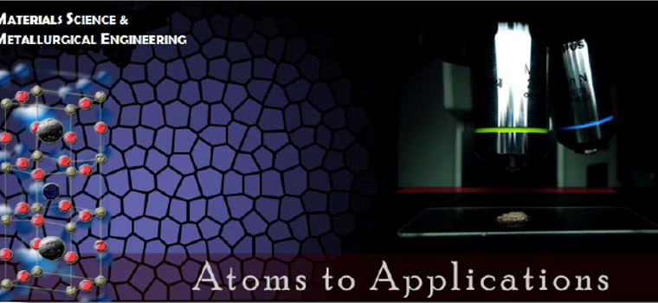
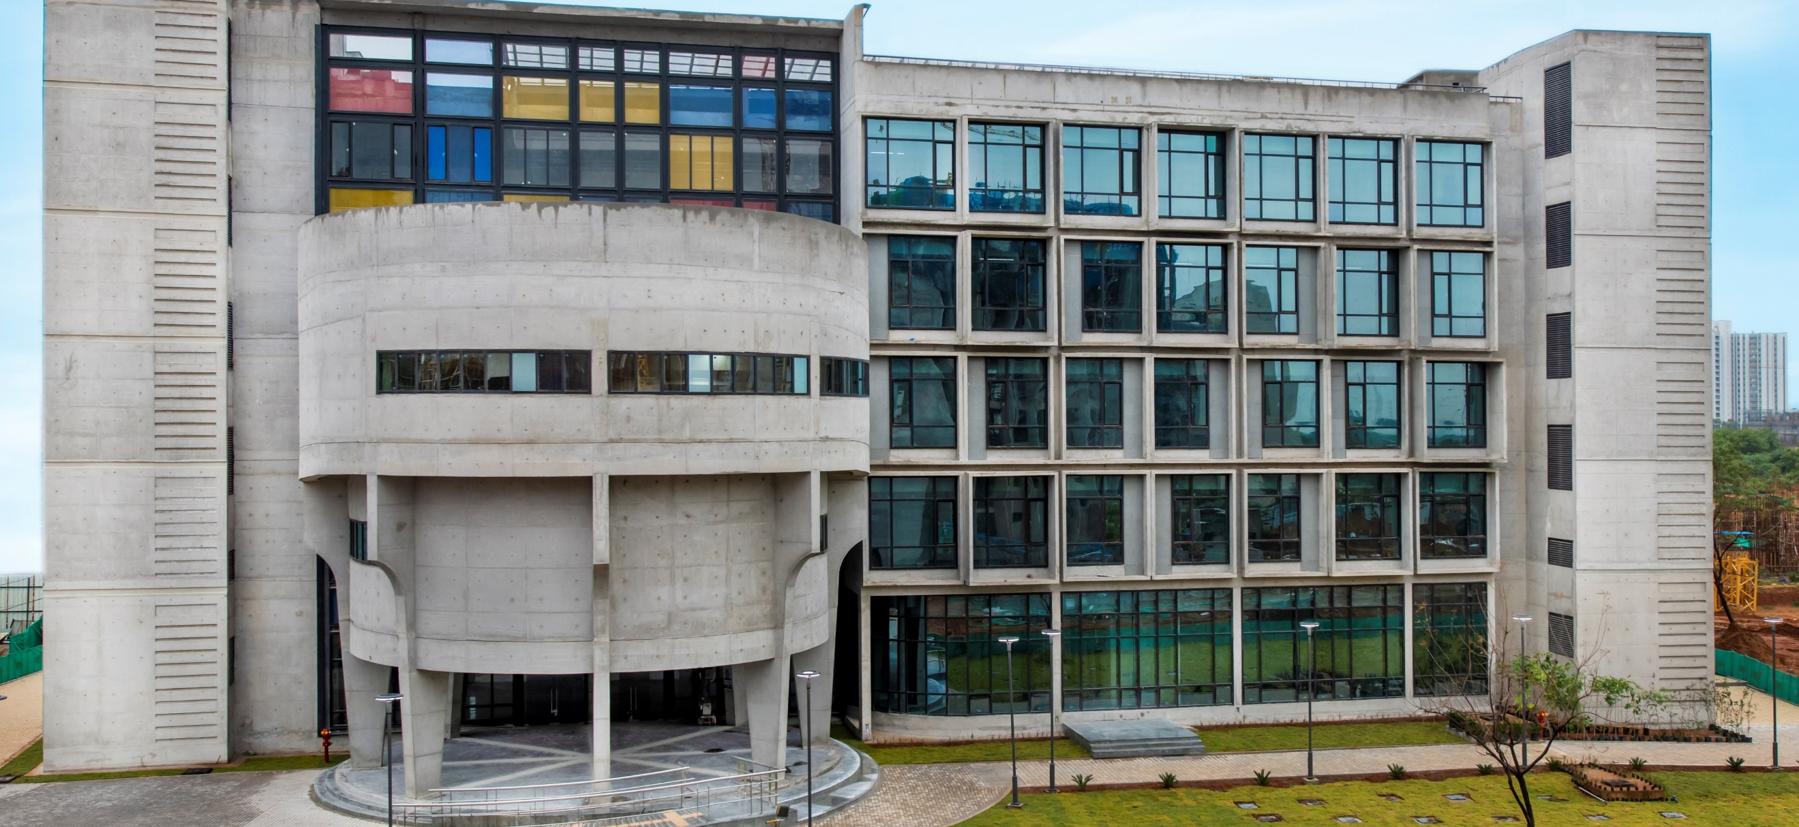
M. Tech. in Semiconductor
Materials and Devices
(A.Y. 2023-24)
Department of Materials Science &
​Metallurgical Engineering
​
https://msme.iith.ac.in/
​

Slide 2
About The Program
The program aims to nurture expertise in Semiconductor Materials and Devices, one of essential resources to make India as the global hub for Electronic Systems and Manufacturing. The program is in line with the recent expansion of the vision of Aatmanirbhar Bharat in setting up of India Semiconductor Mission
By the year 2030, the global need of AI+IoT devices are predicted to be >350 billion (source: 2020 IEEE ISSCC, Cisco VNI Global IP Traffic Forecast 2017-2022).
The specialized degree programs such as Semiconductor Materials and Devices is of paramount importance to meet the technological growth and demands both nationally and globally.
In the recent initiatives of the Indian government Rs.76000 crore (>10 billion USD) has been approved for development of semiconductors and manufacturing ecosystem in the country (source: investindia.gov.in). The current academic program is meant for enthusiastic bright candidates who are willing to take a career path on semiconductor technology.

Slide 3
Courses
  Fundamentals of Semiconductor Materials
  Spintronic Materials and Devices
  Functional Polymers & composites
  2D Materials: synthesis, characterization and applications
  Computational Materials Science
Semiconductor Materials
Testing & Processing
Semiconductor Devices
  Semiconductor Extraction & Purification
  Micro and Nanofabrication
  Solidification Processing
  Electrochemical processes in semiconductors
  Semiconductor Materials Characterization lab
  Semiconductor Devices Characterization lab
  Materials Characterization
  Diffusion analysis in Materials Engineering
  Semiconductor Devices
  Electronic Materials and Devices
  Smart Materials and Transducers
  Flexible Electronics
  Device Simulations
  Thin Film Technology
  Industry lectures on semiconductor devices, electronic packaging and e-waste management

Slide 4
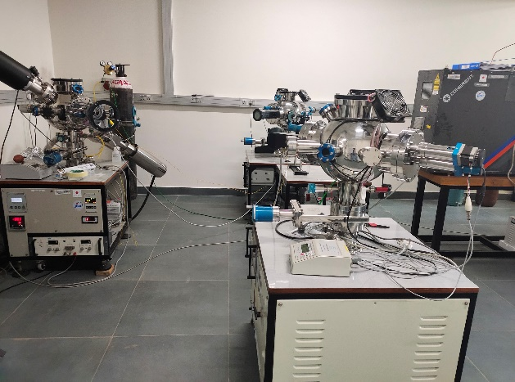
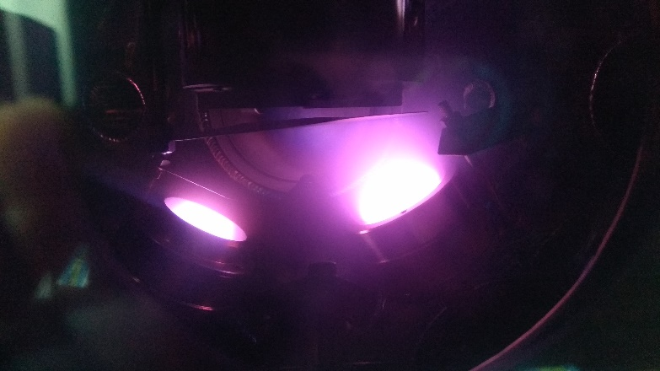
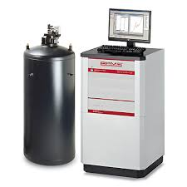
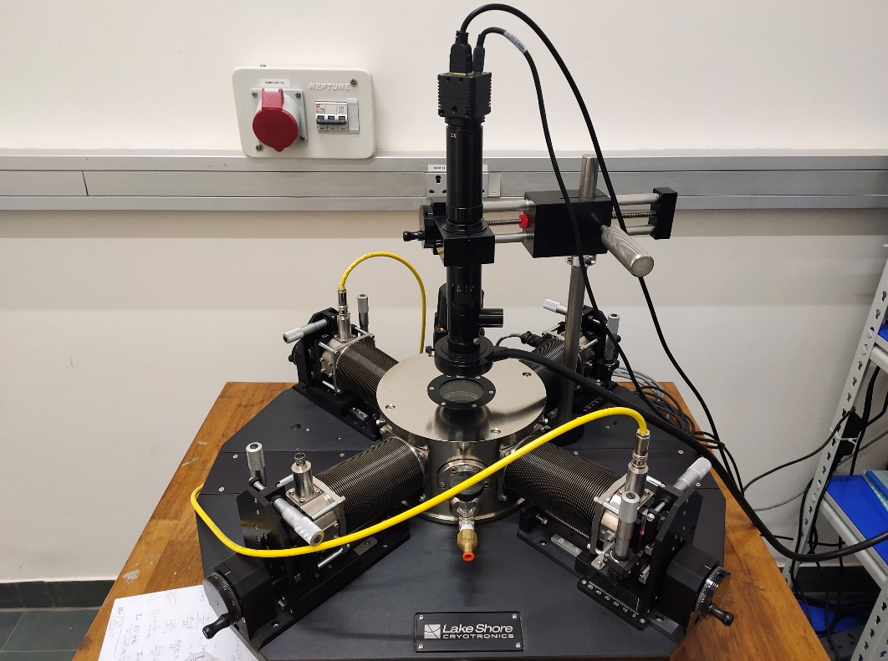
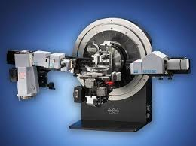
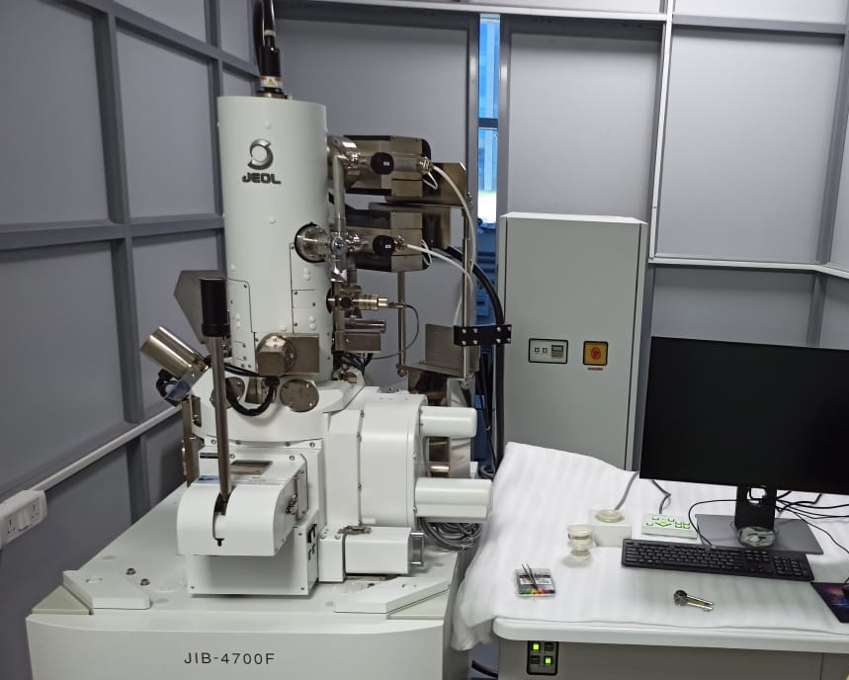
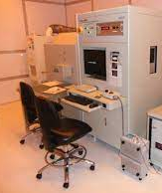
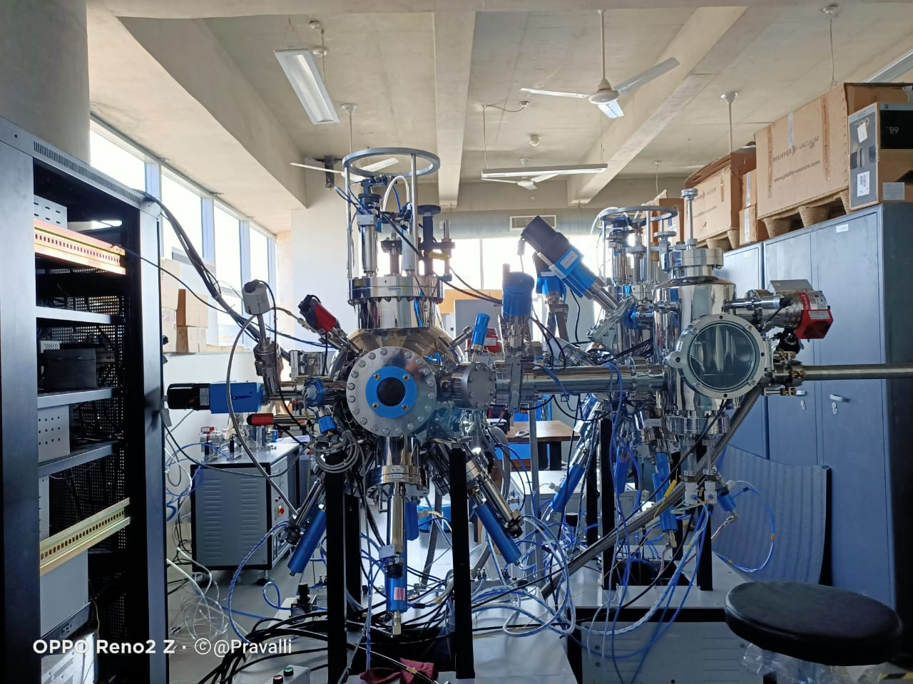
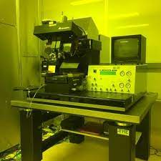
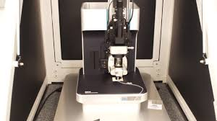
Research Facilities

Slide 5
Eligibility & Admission (A.Y. 2023-24)
MoE Fellowship: Candidates having B.E./B.Tech. or equivalent in Metallurgy /Ceramics /Mechanical /Production /Industrial/Electrical/Electronics/Instrumentation Engineering/Polymer or related discipline or M.Sc. in Materials Science/Nanotechnology/Physics/Chemistry or related discipline with minimum first class. Valid GATE score required in MT/ME/PI/PH/CY/XE for MoE fellowship.
Applications shall be submitted online. Please visit www.iith.ac.in for more details.
Contact: Program Coordinator (M.Tech. in Semiconductor Materials and Devices)
      Department of Materials Science and Metallurgical Engineering
      Indian Institute of Technology Hyderabad
      Kandi , Sangareddy , Telangana 502284, India
      Email: smd@msme.iith.ac.in

Slide 6
Eligibility & Admission (A.Y. 2023-24)
Self-sponsered: Candidates having B.E./B.Tech. or equivalent in Metallurgy /Ceramics /Mechanical /Production /Industrial/Electrical/Electronics/Instrumentation Engineering/Polymer or related discipline or M.Sc. in Materials Science/Nanotechnology/Physics/Chemistry or related discipline with minimum first class. The selection will be based on written test and/or interview for self-sponsored seats. GATE Score is not mandatory.
Applications shall be submitted online. Please visit www.iith.ac.in for more details.
Contact: Program Coordinator (M.Tech. in Semiconductor Materials and Devices)
      Department of Materials Science and Metallurgical Engineering
      Indian Institute of Technology Hyderabad
      Kandi , Sangareddy , Telangana 502284, India
      Email: smd@msme.iith.ac.in

