Slide 1
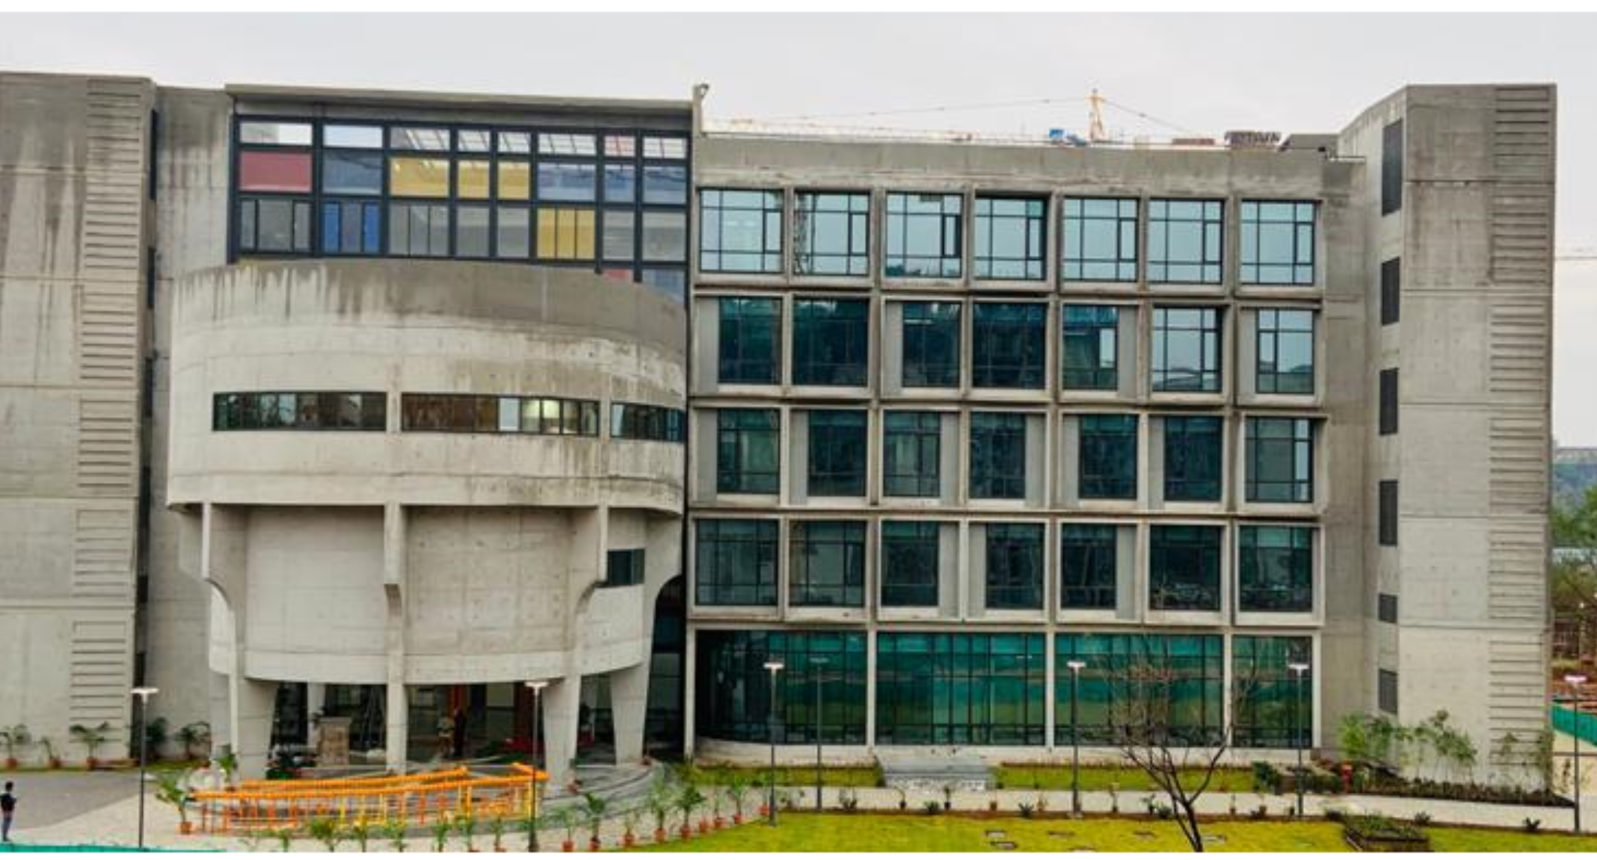
M.Tech Admission
Apply online at
www.iith.ac.in
Department of Materials Science & Metallurgical Engineering
2023-24
Indian Institute of
Technology Hyderabad

Slide 2
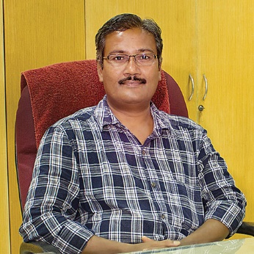
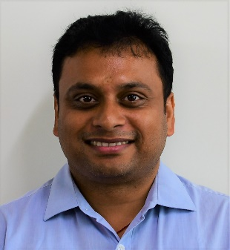
Research Interests: Nanocrystalline materials, High entropy alloys, Bulk metallic glasses, Thermodynamics and kinetics of phase transformations, Transmission electron microscopy and atom probe tomography
MSME Faculty
Prof. B.S.Murty
PhD: IISc Bangalore, India
Contact: bsm@msme.iith.ac.in, +91 (40) 2301 6033
Research Interests: Design and development of novel high entropy alloys for advanced structural applications Development of light metals alloys for novel applications Bulk nano- and heterostructured materials by severe plastic deformation processing Thermo-mechanical and other advance materials processing Crystallographic texture Mechanical behavior of materials
Research Interests: Welding Additive manufacturing
Prof. Pinaki P. Bhattacharjee
PhD: IIT Kanpur, India
Contact: pinakib@msme.iith.ac.in, +91 (40) 2301 6069
Prof. G.D. Janakiram
PhD: IIT Madras, India
Contact: jram@msme.iith.ac.in, +91 (40) 2301 6565
Research Interests: Powder Metallurgy & Sintering Mechanisms, Metal Additive Manufacturing, Nanostructures, High Entropy Alloys, MAX Phases and MXene, Advanced ceramics & composites High temperature materials, Biomaterials Microstructure-Mechanical Properties of Steels Surface modification by Electro-Spark Deposition, Wear & Tribology
Research Interests: Advanced Multi-Functional Nanostructured Materials/High Entropy Alloys Combinatorial Alloy Design of emerging materials (Co-Cu-Fe-Ni-Zn High Entropy Alloys, CIGS & CZTSSe solar photovoltaics, Additive Manufactured Binary & Ternary Ti-based Biomaterials, IFHS Steel) through combined computational (DFT) and experimental techniques (electrodeposition, powder metallurgy, ink jet print)
Dr. Bharat B. Panigrahi
PhD: IIT Kharagpur, India
Contact: bharat@msme.iith.ac.in, +91 (40) 2301 6032
Dr. Suhash R. Dey
PhD, Paul-Verlaine Metz, France
Contact: suhash@msme.iith.ac.in, +91 (40) 2301 6096

Slide 3
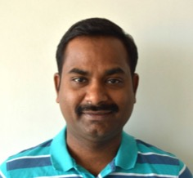
Research Interests: Nanoparticle synthesis and self-assembly, sol-gel processes, templating techniques Novel nanostructured materials for advanced applications including catalysis Solid oxide fuel cells (SOFC), ferroelectric materials Bone replacement materials and drug delivery systems
MSME Faculty
Dr. Atul S. Deshpande
PhD: Max Planck, Potsdam, Germany
Contact: atuldeshpande@msme.iith.ac.in, +91 (40) 2301 7044
Research Interests: Multiferroic oxide thin films for fundamental science and functional device applications High-k dielectric thin films for CMOS technology and memory device applications Surfaces and Interfaces of oxide hetero structures on silicon and single crystalline oxide substrates Influence of process conditions, strain engineering and interface engineering on domains and domain dynamics of multiferroic thin films utilizing scanning probe microscope
Research Interests: Phase transformations in alloys and oxides Phase-field modelling of microstructural evolution Modelling deformation of materials using discrete dislocation dynamics and continuum crystal plasticity Microstructure-property correlations
Dr. Ranjijth Ramadurai
PhD: IISc Bangalore, India
Contact: ranjith@msme.iith.ac.in, +91 (40) 2301 7046
Dr. Saswata Bhattacharya
PhD: IISc Bangalore, India
Contact: saswata@msme.iith.ac.in, +91 (40) 2301 7107
Research Interests: Bacterial cellulose and other natural materials- understanding structure, mechanism and applications High performance green composites, liquid crystals and self-assembly of rod-like entities Drug Delivery, strategies for developing anti-fouling and anti-microbial materials Materials for tissue scaffolding.
Research Interests: Phase Transformations and Microstructure Development Laser and Electron Beam Processing Welding and Surface Treatment Modelling and Simulation,(Phase Field/FEM/CVM)
Dr. Mudrika Khandelwal
PhD: Cambridge, UK
Contact: mudrika@msme.iith.ac.in, +91 (40) 2301 7118
Dr. Subhradeep Chatterjee
PhD: IISc Bangalore, India
Contact: subhradeep@msme.iith.ac.in, +91 (40) 2301 8442

Slide 4
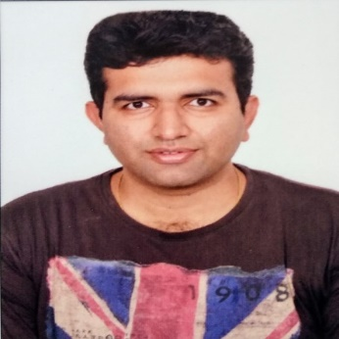
Research Interests: In situ characterization and technique development using MEMS devices (lab on chip) Phase transformations in materials, Electrochemsitry and Corrosion In situ Transmission Electron Microscopy Graphene based super capacitors, Materials for Energy Applications
MSME Faculty
Dr. Sairam K. Malladi
PhD: TU Delft, Netherlands
Contact: srkm@msme.iith.ac.in, +91 (40) 2301 7003
Research Interests: Deformation at room temperature Creep and super-plasticity Micro mechanical deformation Molecular dynamic simulations Nano indentation
Research Interests: Nanophotonics, Plasmonic nanostructures and nanoparticles Metamaterials and metasurfaces, Sensors, Alternative materials for plasmonics Alternative fabrication techniques, Nano-optical biosensors Graphene based devices, Lab-on-a-chip based optical devices, Microfluidic devices
Dr. Rajesh Korla
PhD: IISc Bangalore, India
Contact: rajeshk@msme.iith.ac.in, +91 (40) 2301 6559
Dr. Shourya Dutta Gupta
PhD: EPFL, Switzerland
Contact: shourya@msme.iith.ac.in, +91 (40) 2301 6561
Research Interests: Spintronic based memory and logic devices Nanomagnetic materials, Domain wall dynamics in ferromagnetic networks Spin torque nano-oscillators for RF applications Spin-orbit torque induced magnetization switching and dynamics, Magnetic tunnel junctions Micro and Nanofabrication techniques
Research Interests: Diffusion-Deformation correlations in materials Phase growth and interdiffusion kinetics in thermoelectric materials Diffusion in multicomponent alloys Processing, characterization and stability of nanocrystalline alloys
Dr. Chandrasekhar Murapaka
PhD: NTU Singapore
Contact: mchandrasekhar@msme.iith.ac.in, +91 (40) 2301 6562
Dr. Mayur Vaidya
PhD: IIT Madras, India
Contact: vaidyam@msme.iith.ac.in, +91 (40) 2301 6564

Slide 5
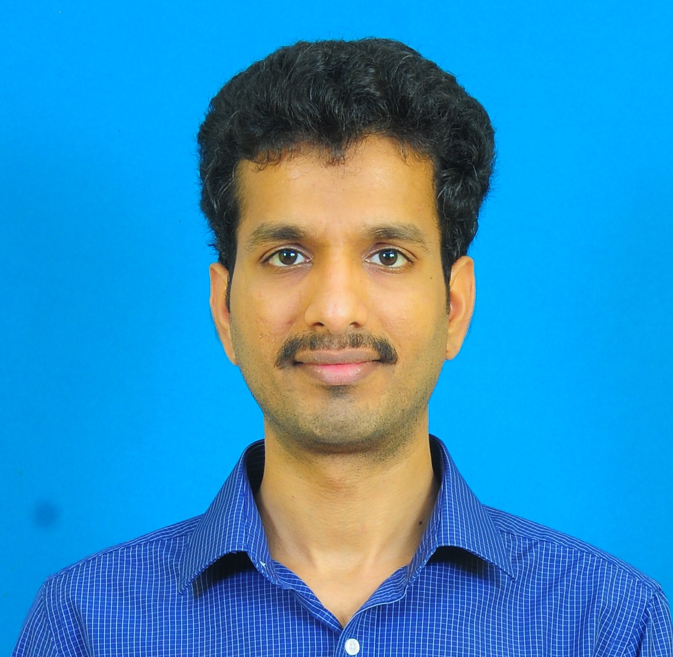
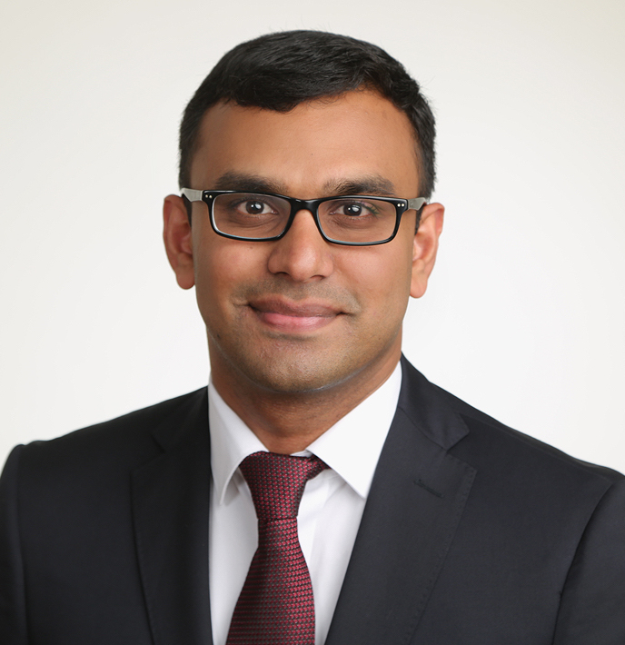
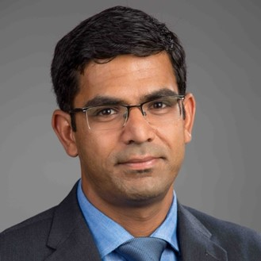
Research Interests: Printed electronics (transistors and CMOS logics) Oxide semiconductors Electrolytes Organic electronics (transistors and chemiresistors) Gas sensors Memristors
MSME Faculty
Dr. G. Suresh Kumar
PhD: TU Darmstadt, Germany
Contact: gsuresh@msme.iith.ac.in, +91 (40) 2301 7003
Research Interests: Thin film growth in-situ stress measurements Thin film mechanics Mechanical behavior of nanostructures Micro-electronic packaging, lead free solders
Research Interests:
Nanoporous materials
CVD, Adsorption and Membrane based gas separation applications
Defect Engineering in porous materials
Carbon nanomaterials, MOFs
Graphene & Graphyne and other 2D materials
Dr. Piyush V Jagtap
PhD: IISc Bangalore, India
Contact: piyush.jagtap@msme.iith.ac.in
Dr. Deepu Babu
PhD: TU Darmstadt, Germany
Contact: deepubabu@msme.iith.ac.in, +91 (40) 2301 6562
Research Interests: Computational Material Science Electronic structure theory Defects thermodynamics Metals and semiconductors First Principle Calculations Multiscale Modelling AI/ML
PhD:
Research Interests: Process metallurgy Physical modeling of unit processes Iron and steelmaking Life cycle analysis of processes and products Development of alloy steels
Dr. Anuj Goyal
PhD: University of Florida, USA
Contact: anujgoyal@msme.iith.ac.in, 6564
Dr. Ashok Kamaraj
PhD: CSIR-NML, Jamshedpur
Contact: ashokk@msme.iith.ac.in +91 (40) 2301 6566

Slide 6
Research Areas - MSME
Sensors
Magnetic Materials, Spintronics, Magnetic Skyrmions
Plasmonics, Nanophotonics, Micro-fluidics
Nano synthesis, Self-assembly,
Catalysis
Electro-chemical deposition of functional materials
Nature Inspired Materials
Healthcare Materials, Drug Delivery, Tissue-scaffolds, Porous Implants and Biomaterials
Energy Storage Materials, 2D Carbon Materials, MXene
Piezoelectric hybrid nano composites,
Graphene based Supercapacitors, Solar Photovoltaics
Electronic materials
Defect engineering for porous materials
Functional Materials
Computational Materials Science
Structural Materials
Grain Boundary Engineering
Mechanical Behaviour, Plastic Deformation
Phase Transformation, solidification
Metals and Alloys: High Entropy Alloys, Multi-Phase Alloys, Titanium Alloys, Superalloys, Steels, Dispersion Strengthened Alloys
Bulk-Metallic Glasses, In-situ Composites
Metallurgical Thermodynamics and kinetics
Severe Plastic Deformation
Thermomechanical Processing, Texture
Nanocrystalline materials, Ultra-fine microstructures
Creep and high temperature deformation
Powder Metallurgy, Advanced Composites, MMC
Multicomponent Oxides, Nanoparticles, Ceramics
Coating, Surface Science, Wear and Tribology
Advanced microscopy
Metal Joining, Friction Stir Welding, Additive Manufacturing
Diffusion in pure metals and multicomponent alloys
Mechanics of nanoporous materials
Corrosion in bulk and nanocrystalline alloys
Low Temperature solders
Process metallurgy and process modelling
Iron and steel making
Phase-field Modelling, Combinatorial materials science
Modelling Deformation Behavior Using Discrete Dislocation Dynamics,
Continuum Crystal Plasticity
Multi-scale Modelling of Functional Materials
Atomistic simulations. AI/ML

Slide 7
Research Facilities - MSME
Materials Synthesis/Processing
Materials Characterization
Pulse Laser Deposition
E-beam deposition
Planetary Ball mill
Rolling mill
Robotic welding
Uniaxial Compaction Press
Cold-Isostatic Press
Induction-melting furnace
Arc-melting furnace
Hot press
High Temperature Vacuum Furnace
Infra-red heating furnace
Muffle furnace
Tube furnace
Salt-bath furnace
Autoclave Ovens
Incubator shaker
Freeze drier
Bio-safety cabinet
Glove-box
Glass vacuum sealing
Spin and Dip coater
Cold FEG-TEM
FEG- SEM with EBSD
FIB with EBSD and EDS
Optical Microscopes
Ion-milling, PIPS
Thermal analysis
DTA, DSC, TGA, Dilatometer
Surface area and porosity analyser
Powder & thin film XRD
UV visible spectrophotometer
Raman spectrometer
AFM
Universal testing machine (MTS, Instron)
Creep Testing
Hardness Tester
Wear (Pin-on-disk)
Nanoindentor
Electrochemical analyzer
Viscometer
Softwares
Thermocalc
DICTRA
TC-Prisma

Slide 8
M.Tech Program (MoE Fellowship)
Glimpses of advanced level courses offered
Department offers 2-years program in Master of Technology in Materials Science and Metallurgical Engineering. Students get opportunity to learn various advanced level courses and carryout thesis in various cutting-edge areas.
ELIGIBILITY:
Candidates having B.E./B.Tech. or equivalent in Metallurgy/ Ceramics/ Mechanical / Production / Industrial / Plastics / Polymer/ or related discipline or M.Sc. in Materials Science/Physics/Chemistry Valid GATE score required in MT/ME/PI/PH/CY/XE.
SELECTION PROCESS:
Based on GATE SCORE
APPLICATION PROCEDURE:
visit www.iith.ac.in for detail
information and apply online
Properties of Materials
Electron Microscopy
Thermomechanical Processing Of Materials
Advanced Physical Metallurgy
Advanced Materials
Thin Films Technology
Advanced Materials Synthesis And Characterization
Composite Materials
Scientific Writing And Ethics In Research
Materials For Green Energy
Powder Metallurgy Manufacturing
Introduction To Computational Methods In Materials Science
Biomaterials- Materials In Medicine
Polymer Science And Engineering
Thermodynamics And Kinetics Of Materials
Electrochemistry in Materials Science and Engineering
Soft Materials
Phase Transformations
Hierarchical Nanostructured Materials
Nature Inspired Materials Engineering
2D Materials: Synthesis, Characterization and Applications
Wear & Triobology
Contact for M.Tech Program (MoE Fellowship):
Dr. Rajesh Korla
Assistant Professor
Department of Materials Science &
Metallurgical Engineering
Email: rajeshk@msme.iith.ac.in
Phone: 9676468326

Slide 9
M.Tech Program (Self-sponsored)
Glimpses of the courses offered
Department offers two years program in Master of Technology in Materials Science and Metallurgical Engineering. Students get opportunity to learn various advanced level courses in various cutting edge areas.
ELIGIBILITY:
Candidates having B.E./B.Tech or equivalent in Metallurgy/ Ceramics/ Mechanical/ Production / Industrial / Plastics / Polymer or related discipline.
M.Sc. or equivalent degree in Materials Science/Physics/Chemistry or related discipline with minimum first class.
SELECTION PROCESS:
Written test (and/or) interview
GATE SCORE NOT MANDATORY
APPLICATION PROCEDURE:
visit www.iith.ac.in for detail
information and apply online
Properties of Materials
Electron Microscopy
Thermomechanical Processing Of Materials
Advanced Physical Metallurgy
Advanced Materials
Thin Films Technology
Advanced Materials Synthesis And Characterization
Composite Materials
Scientific Writing And Ethics In Research
Materials For Green Energy
Powder Metallurgy Manufacturing
Introduction To Computational Methods In Materials Science
Biomaterials- Materials In Medicine
Polymer Science And Engineering
Thermodynamics And Kinetics Of Materials
Applications of Electrochemistry in Materials Science and Engineering
Soft Materials
Phase Transformations
Hierarchical Nanostructured Materials
Nature Inspired Materials Engineering
2D Materials: Synthesis, Characterization and Applications
Wear & Triobology
Contact for M.Tech. Program
(Self-sponsored):
Dr. G. Suresh Kumar
Assistant Professor
Department of Materials Science &
Metallurgical Engineering
Email: gsuresh@msme.iith.ac.in
Phone: 91009 30553

