Slide 1
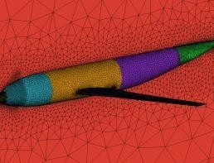
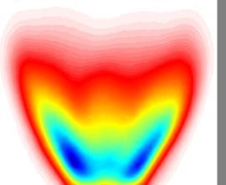
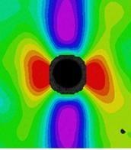
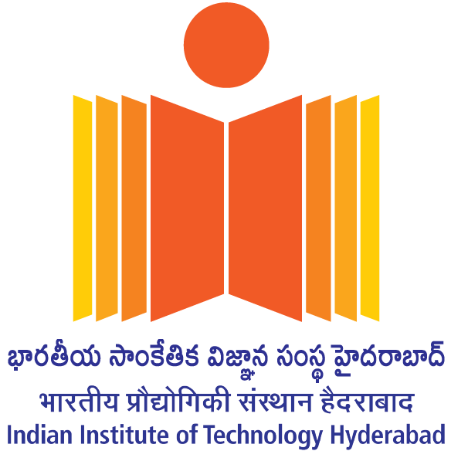
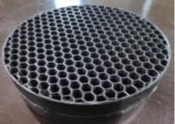
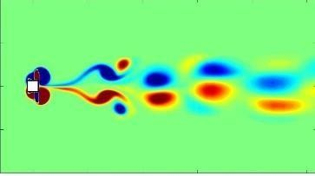
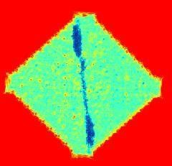
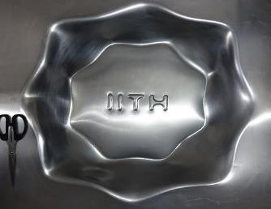
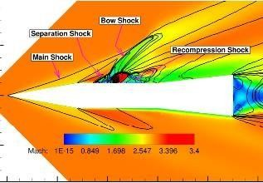
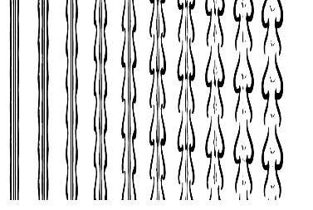
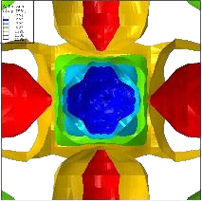
M. Tech Admissions Mechanical & Aerospace Engineering Department, Indian Institute of Technology Hyderabad

Slide 2
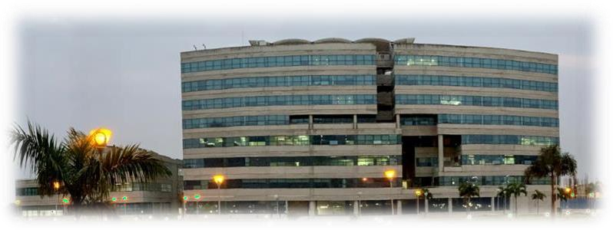
The Institute
Started in 2008, IIT Hyderabad added another link to the chain of the premier institutions of the country - The IITs, known world over for extraordinary excellence in academics, research and technology. IIT Hyderabad aims to carry this tradition of excellence forward with its brilliant students, extraordinary faculty, state of the art facilities and cutting-edge research. In its first year, IIT Hyderabad had B.Tech. programs in Computer Science and Engineering, Electrical Engineering and Mechanical Engineering; with a total student strength of 111. Keeping its thrust on research, the PhD program was started in January 2009 and the M.Tech. program in August 2009. At present the institute has 19 departments covering all the major engineering, science and humanities disciplines, offering B.Tech., M.Tech., M.Sc. and PhD with a total strength of more than 4800. IIT Hyderabad started functioning from August 2008 from its temporary campus located in Ordnance Factory, Medak District (Andhra Pradesh). On 27 February 2009, on its main campus in Kandi, the foundation stone of IIT Hyderabad was laid by Smt. Sonia Gandhi, Hon’ble Chairperson of UPA.
Inventions and innovations are keywords on which the foundation of IIT Hyderabad is based. These are also the key drivers for the vision of IIT
Hyderabad. Our endeavor is to create an institution that will provide a space for free and uninhibited thinking, a space where faculty and students can experiment with novel ideas without the fear of failure.
Indo Japan Collaboration:
IIT Hyderabad has active collaboration with Japan. This involves joint
research projects, exchange of faculty and students.
National Knowledge Network:
IIT Hyderabad has been identified as one of the participating institution for
National Knowledge Network (NKN), a MHRD initiative to bring together all
the stakeholders in Science, Technology, Higher Education, Research and Development, and Governance with speeds of the order of gigabits per second coupled with extremely low latencies, and to help the country evolve as Knowledge Society. Six virtual classrooms over NKN have been established at six IITs including IIT Hyderabad, IIT Madras and IIT Bombay. The initial phase of National Knowledge Network (NKN) was inaugurated by
H.E. Smt. Pratibha Patil, Honarable President of India on April 9, 2009

Slide 3
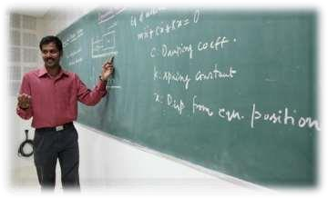
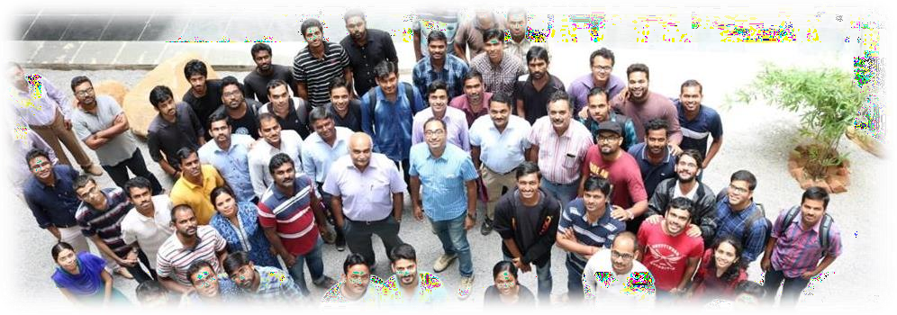
The Department
The Department of Mechanical Engineering aims at pushing the frontiers of modern science and engineering through quality teaching and cutting edge research. In order to make the nation self-sufficient, it is highly motivated to invest in state-of-the-art manufacturing technology and address the issue of energy in the context of global energy environment.
Right from its inception in 2008, it has attracted a rich and diverse set of talented individuals, currently nurturing 228 undergraduates and 242 postgraduates, who are trained in the nuances of the field by highly qualified faculty
The department presently offers MTech in (a) Mechanics and Design (b) Integrated
Design and Manufacturing (c) Thermofluids Engineering (d) Aerospace Engineering in addition to BTech in Mechanical and a Ph.D. program.
➢
The faculties are well experienced and very enthusiastic about
research and practical learning. All of them are at the foremost in their field of research. Major areas of faculty expertise includes CFD, Acoustics and Vibration, Dynamics and controls, Mechatronics, Thermodynamics, Multiphase flows, Process Modeling and Optimization, Manufacturing, Linear and Nonlinear Vibrations, FEM, Fracture Mechanics, Rapid Prototyping, MEMS, NEMS, Composites, Impact Mechanics and CNC
Machining. The faculty has been actively involved with industry and research organizations with work experience in DRDO, DST, BHEL, NRB, GM etc.

Slide 4
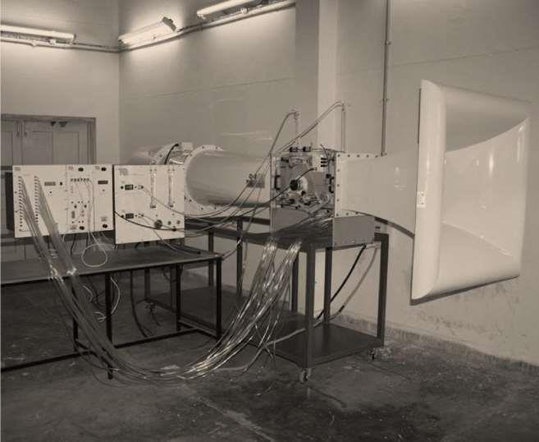
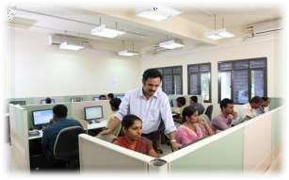
Facilities
The Department boasts of following state-of-the-art laboratories for undergraduate, graduate and doctoral students:
Acoustics and Vibration lab
Applied Micro & Nano Mechanics Lab
Computer Aided Engineering Lab
Dynamics of Machinery Lab
Engineering optics lab
Fluid Mechanics Lab
Heat Transfer
IC Engine
Combustion and Flow Diagnostics
Machining & Metrology Lab
Manufacturing Lab
Mechatronics Lab
Rapid Prototyping and Manufacturing lab
Solid Mechanics Lab
Composite Fabrication Lab
Impact Mechanics Lab
Micro-Mechanics Lab
MEMS & NEMS Lab
Vehicle Dynamics Lab
NDT & E Lab
Computing Facilities:
High end workstations equipped with extensive scientific and engineering softwares such as Rapid Prototyping & Manufacturing LabANSYS, MATLAB, FLUENT, MAPLE, Solid Edge, Unigraphics, Hyperworks, ADAMS, LMS Virtual Lab, VA One etc.
A state-of-the-art High Performance Computing cluster is also available to perform computationally intensive research

Slide 5
Faculty and Research Areas
For research areas and faculty interests visit:
https://mae.iith.ac.in/faculty-directory.html
Faculties having project-based vacancies:
Contact office@mae.iith.ac.in or dpgc@mae.iith.ac.in

Slide 6
The Admission Process
The Streams in which to Apply: -
There are Four Departmental Streams in which a student can apply
for M. Tech. These are:-
a) The Mechanics and Design (MAD) stream; b) The integrated Design and Manufacturing Stream (IDM); c) The Thermo-Fluid Engineering Stream (TFE) and d) Aerospace Engineering Stream (AE)
Who can Apply: -
There are Four categories through a candidate can apply for the M.
Tech Program
MoE Mode: Candidates who have qualified GATE must register on the Common Offer Acceptance Portal (COAP). Once all the COAP admission rounds are over, the leftover seats are filled based on GATE score and performance on written test and/or interview. The candidate can join a 2-Year M. Tech program through this mode.
Once admitted, candidates are paid a stipend according to MoE norms.
IIT B. Tech Mode : Candidates who have a B. Tech degree from any IIT with a CGPA of 8 and above can apply in this mode. Once
admitted, candidates are paid a stipend according to MHRD norms. Selection is based on a written test and/or interview. It is a 2-year M. Tech program.
B. Tech Stream | GATE SCORE IN (non IIT MHRD candidates) | Eligibility
Either of :- Mechanical Engineering, Aerospace/Aeronautical Engineering, Automobile Engineering, Production and Industrial Engineering, Manufacturing Engineering | Mechanical Engineering | MAD, TFE, IDM, AE
 | Aerospace Engineering | MAD, TFE, AE
 | Production Engineering | IDM
Civil Engineering or AESI degree | Aerospace Engineering or Mechanical Engineering or Production and Industrial Engineering | AE
B. Tech Stream | Eligibility (IIT and non-MHRD candidates)
Mechanical Engineering | MAD, TFE, IDM, AE
Aerospace/Aeronautical Engineering | MAD, TFE, AE
Automobile Engineering | MAD, TFE, AE
Production and Industrial Engg, Manufacturing Engg. | IDM
Civil Engg and AESI Degree | AE

Slide 7
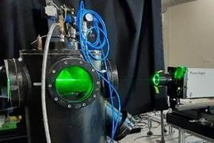
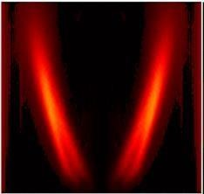
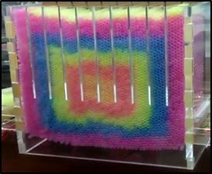
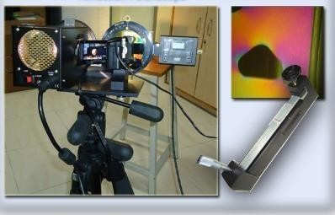
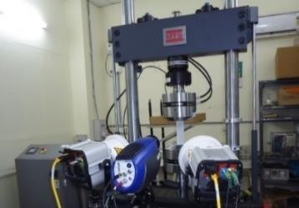
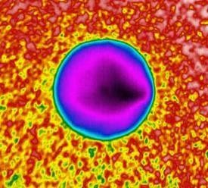
The Admission Process
Project Mode: GATE-qualified candidates or candidates with at least 6 months experience in the MAE department of IITH can join the 3-Year M. Tech program. Admission is given to shortlisted candidates based on their performance in the written test and the interview. These students will work on projects funded by external agencies, and the funding is subject to the availability of the project during the selection process. A stipend is given to these candidates, subject to the norms of the funding agency.
Self-Sponsored Mode: We have started a self-sponsored 2-year M. Tech program, and a lot of students have been admitted under this category. Admission is given to shortlisted candidates based on their performance on the written test and an interview. This is a non-subsidized program, and no
financial support is provided to the students. The fee for this program is approximately 11 Lakh rupees for two years. More details about the program can
be found on the IITH website. Candidates can apply for any one of the streams.
The eligibility requirements for the various streams are listed in the Table. Note that a GATE score is not required for self-sponsored, IIT, and project-mode candidates. Further Information is available at
https://mae.iith.ac.in/grad-admissions.html

Slide 8
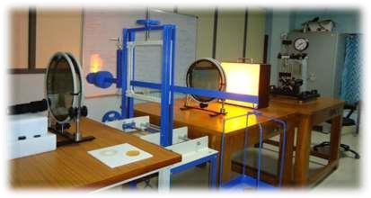
Specializations
Integrated Design & Manufacturing
The growing complexity of the challenges in Industry and Research these days demand an interdisciplinary approach. It can be easily observed that industry today prefers workforce versatile in both the analysis and practical implementation; in component as well as system design; in theoretical as well as computational approaches. The conventional M.Tech. pedagogy of small number of courses (8-10) in the short duration of one year limits the implementation of the foregoing. The fractal program in Integrated Design & Manufacturing aims to address this problem by fractalizing the courses into modules of varying credits between 1-3. The student can then gain a wide knowledge base through one or two credits’ modules and greater depth through the electives.
The compulsory courses include Manufacturing Processes, Design for Manufacturability & Assembly, FEM, Computational labs related to FEM and CFD analysis, Material Science & Material Selection, Scaling Laws & Multi-scale Manufacture, Computer Integrated Manufacturing, Elasticity & Plasticity, Fluid Mechanics & Heat Transfer, Process Control & Optimization, Artificial Intelligence. The students can choose a core manufacturing elective from advance courses in material removal, joining and generative process. In addition, open electives can be chosen from the following list of tentative electives: Automation & Robotics, Additive Manufacturing, Micro-Manufacturing, Measurement Science &
Techniques, Reliability & Fault Diagnostics, Fatigue, Fracture & Life Cycle Estimation etc. (Note: most of these courses are 1-credit i.e., one-third of duration of a normal course).
Thermo-Fluid Engineering
Utilization and efficient management of fluid flow and energy conversion are important aspects in almost all engineering applications. In this discipline, the students are exposed to fundamental and advanced concepts in fluid mechanics and energy transfer through course works and research. The students learn the theoretical concepts through course

Slide 9
Specializations
works and get hands-on experience through laboratory work. They also get a taste of cutting-edge research through their thesis work. At the end, the graduating students are trained in skills that are highly sought after by the industry. Additionally, students who are interested in research have the necessary technical expertise to pursue a Ph.D. degree in India or abroad.
Initially, students take fundamental courses like advanced fluid mechanics, heat transfer, CFD, combustion, along with a course on mathematics, which prepare them for the advanced courses in the field. These advanced courses are in CFD, Interfacial phenomena including capillarity, Soft Matter, Turbulence, Reacting Flows, Thermodynamics, Combustion, Optical Diagnostics, Compressible Flow, IC Engines, etc.
Students also get hands-on experience in using the Wind Tunnel,
Advanced heat transfer experimental test rigs, and CAE tools as part of their laboratory course work. In their second year, the students dedicate their time solely towards thesis research. Some of the cutting-edge research topics in this specialization include thin film dynamics, atomization of non-Newtonian fluids, multiphase flows for biomedical applications, fundamentals and applications of cavitation, modeling of wind turbines, bio-fuels and their combustion characteristics, electric vehicles and thermal management of batteries, advanced experimental techniques for fluid mechanics, and motility and hydrodynamics of active soft matter. During their thesis research, the students get the opportunity to implement some of the advanced topics that they learnt during their
course works. Often, these research topics maybe externally funded projects, and therefore, the students get a chance to work on industrially relevant problems.
Mechanics & Design
This program aims at preparing the students for an exciting career in engineering analysis and design, paving way for an exciting career in several automotive, aerospace, energy, and defense sectors. GE, Mercedes-Benz, Mahindra and Mahindra, Infotech, Eaton, and TCE are some of the companies who have participated in the placements in the past. This program also prepares the students for a research career if the students is interested in pursuing Ph.D. The students will take the following compulsory courses: advanced mechanics of solids, finite element analysis, dynamics and vibration. Elective courses include fracture mechanics, advanced finite element analysis, nonlinear oscillations, engineering noise control, composite structures, experimental solid mechanics, multibody dynamics, vehicle dynamics, and advanced mathematical tools. State of the art computational and experimental facilities are available for carrying out the thesis work.
Aerospace Engineering
The master’s program in Aerospace Engineering trains skilled engineers for
their careers in the Aerospace industry and related fields. At present, the

Slide 10
Specializations
programme offers specialisation in Aerospace Structures. The students are exposed to fundamental concepts in flight mechanics, Advanced structural mechanics, and Aerodynamics through course works and projects. At the end of the programme, students have a solid theoretical foundation in aerospace modelling, analysis and design and a general ability to approach and solve complex engineering problems.
In the first semester the students take a mandatory course in Mathematical methods for Engineers and fundamental courses like Introduction to flight and Aerospace structural mechanics. In addition, they are required to do a course on finite element method to solve aerospace related problems. In the second semester, students take specialised courses like flight vehicle aerodynamics and mechanics of composite structures. In addition, they can also select elective courses related to their project work.
In the second year of the programme, the students solely carry out their project work. State of the art research problems in the area of Light weight design of Aerospace structures, Fatigue and fracture of materials, Aeroacoustics, Aero-elasticity, Non-destructive evaluation and Structural health monitoring techniques etc. are being addressed. As part of their research work, the students will apply the concepts learnt during their course work to solve complex problems. The students will be trained in commercial CAE software like ABAQUS, ANSYS etc. to perform numerical simulation related to their project. Also, student will be using latest
equipment for carrying out their experimental work on fabrication and testing of aero-structures. At the end of the program, the students are trained and ready for industrial jobs as well as to pursue a PhD degree in India or abroad.

Slide 11
Contact Details:
MTech Admissions
Department of Mechanical and Aerospace
Engineering
Indian Institute of Technology Hyderabad, Kandi Sangareddy -
502285
Telangana State
Phone: 040-23016650
Email: me_admissions@iith.ac.in

