Slide 1

teaching methods
Harish N Dixit
Department of Mechanical & Aerospace Engineering
IIT Hyderabad
TEQIP workshop
“Educators for 21st Century Engineers”
IIT Hyderabad

Slide 2
on teaching
“What counts, I found, is not what you cover, but what you uncover. Covering subjects in a class can be a boring exercise, and students feel it. Uncovering the laws of physics and making them see through the equations, on the other hand, demonstrates the process of discovery, with all its newness and excitement, and students love being part of it.”
― Prof. Walter Lewin, For the Love of Physics
Teaching is a dialogue, not a monologue
  Paraphrasing Shubha

Slide 3
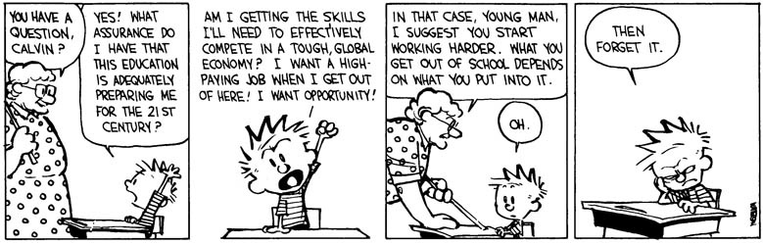
Words of wisdom to Calvin

Slide 4
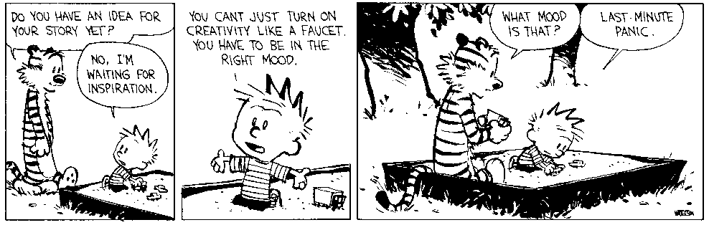
Attitude of many students towards exams

Slide 5
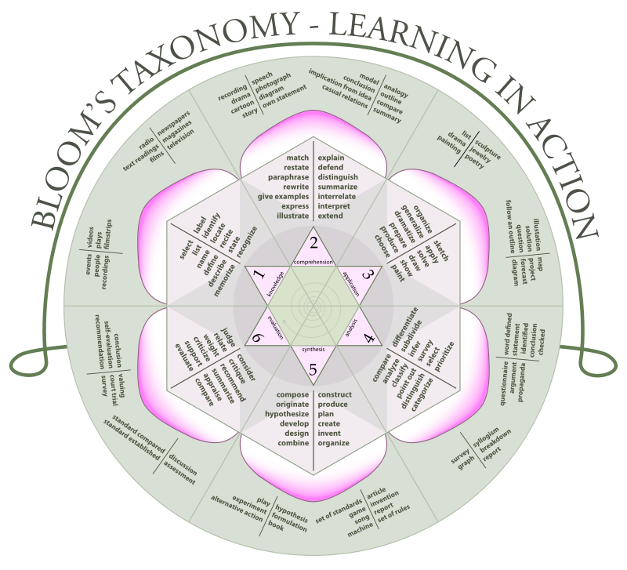
Bloom’s taxonomy
Courtesy: K. Aainsqatsi, Wikipedia
Notes:
Devised by Benjamin Bloom
Objectives that the educators set themselves (learning objectives): Three domains: cognitive, affective and psychomotor.
Cognitive: knowing/head
Affective: Feeling/heart
Psychomotor: Doing/hands

Slide 6
Goals of this session
This session is meant to
  Familiarize you with new teaching aids
  Familiarize you with course material resources
  Help you understand assessment and evaluation goals

Slide 7
Challenges for an instructor
How to communicate to the student our passion for the subject?
How to make the lectures exciting and interesting?
With English as the medium of instruction, how to manage students with a wide range of communication skills?
Can all the technology available to students be used to augment teaching in classrooms?
How to make the classroom a less stressful environment?
How to handle large classes?

Slide 8
Potential solutions
Interactive classrooms
Supplementary material either in the form of videos, projects, computer codes – not all teaching needs to be done in class
A friendly instructor
Continuous assessment as a feedback mechanism – two way feedback
Encourage students to think about potential applications
Rotate seating arrangement
Switch roles between student and instructor
Use lab sessions to break the monotony

Slide 9
Doing the basics right
Irrespective of what teaching methods one follows, it is important to have
  Clear course objectives
  Clear lecture plan
  Clarity in evaluation
  Well defined course outcomes

Slide 10
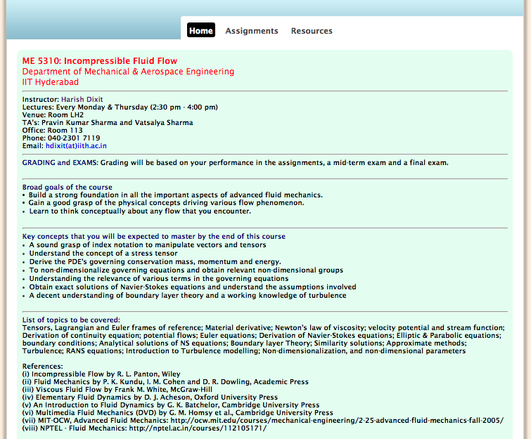

Slide 11
Innovation in teaching
Flip Teaching
Distributed teaching
Clickers
Online course material
Computer programs
Lab sessions in a theory course

Slide 12
Flip Teaching
Traditional Teaching:
  Students listen to lectures and take tests in the classroom
  Reading and assignments are done at home
  Tried and tested approach
Flip Teaching:
  Students first study the topic by themselves at home using video lectures prepared by the instructor
  Classroom is used for clarifications, conceptual discussions, practical applications of the concept, etc.
  Problem solving in the classroom
In general, it is best to use a complimentary approach

Slide 13
How to make a video lesson
Tools:
  Computer or touch screen tablet
  Screen capturing software (Camtasia, QuickTime, etc.)
  Microphone for recording audio
  Digital writing pad with good stylus
What I use:
  My laptop (free)
  QuickTime for screen capture (free)
  Inbuilt microphone
  Wacom-One writing pad with stylus (about Rs. 7,500/-)

Slide 14

Example of a flip Video

Slide 15
Web-based tools
NPTEL: http://nptel.ac.in
Khan Academy: https://www.khanacademy.org/
MIT-OCW: http://ocw.mit.edu/index.htm
edX courses: Jointly founded by MIT and Harvard
  Many partner institutions including IIT Bombay
  https://www.edx.org
Coursera: Free online courses in a wide range of disciplines and languages
  Mass Online Open Courses (MOOC)
  https://www.coursera.org

Slide 16

NPTEL
National Program on technology enhanced learning
World’s largest collection of online course material
A joint initiative of IITs and IISc
More than 810+ courses with than 16648 videos
Multiple courses by different instructors on the same topic
980 institutions officially using NPTEL
200 million page views
Funded by MHRD

Slide 17
NPTEL
National Program on technology enhanced learning

Slide 19
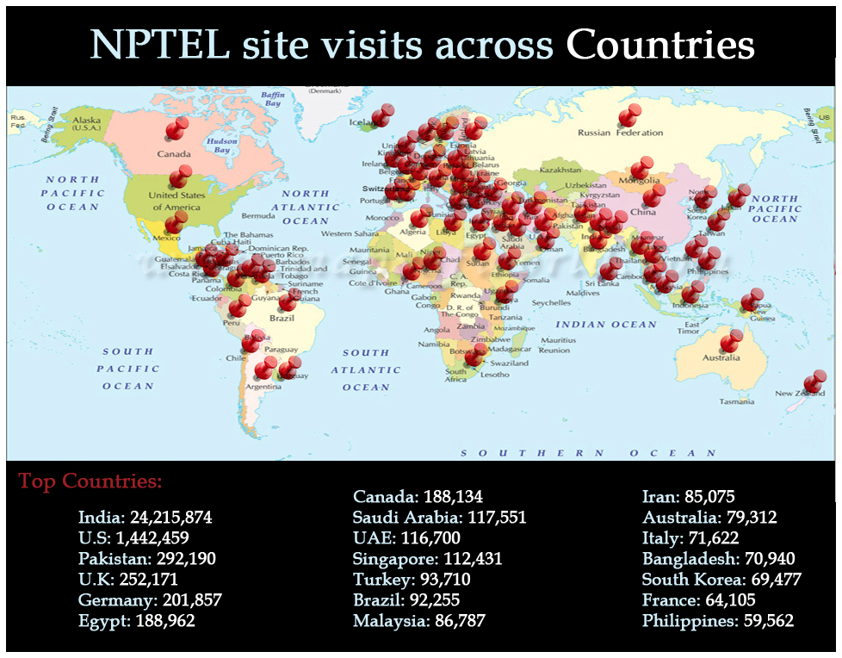

Slide 20

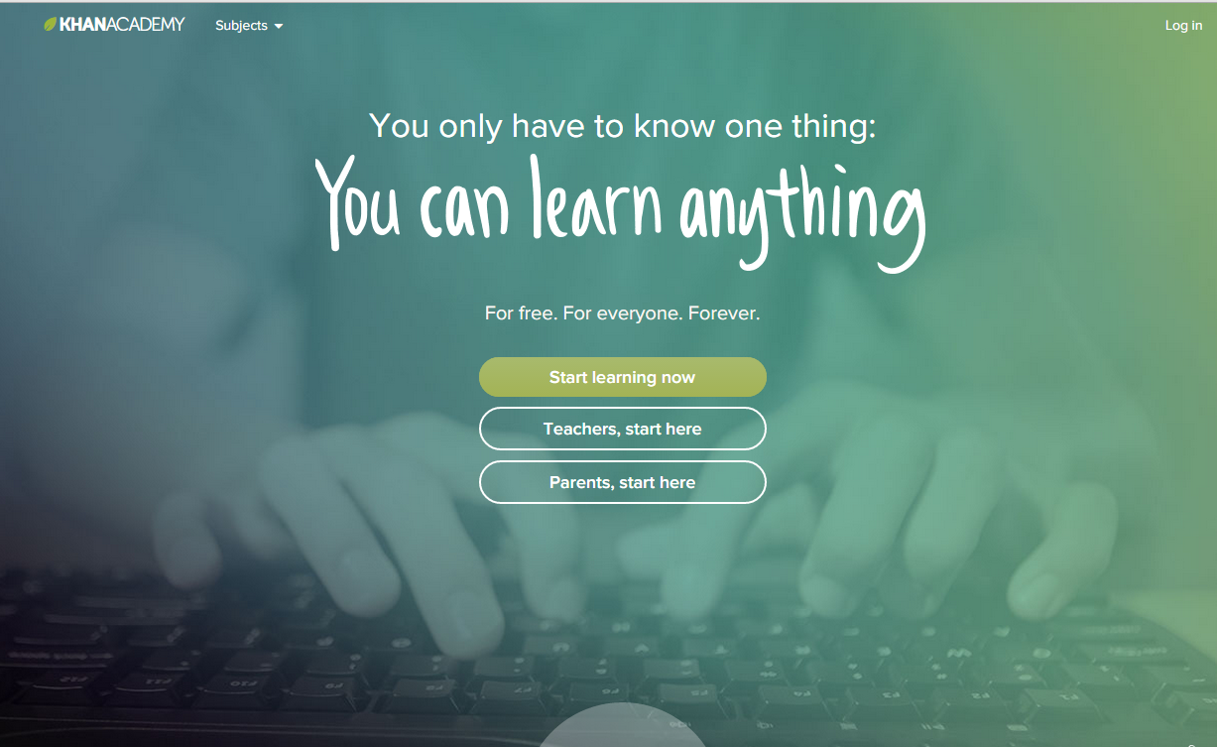
Our mission is to provide a free, world‑class education for anyone, anywhere – Salman Khan

Slide 21
Khan Academy

Slide 22

First law of thermodynamics

Slide 23
Create your own course on khanacademy.org

Slide 24

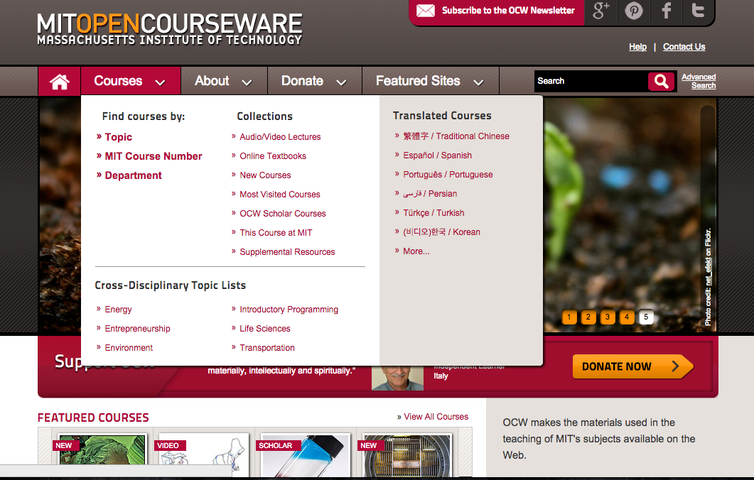
Unlocking Knowledge
  MIT OpenCourseWare (OCW) is a web-based publication of virtually all MIT course content. OCW is open and available to the world and is a permanent MIT activity.
“The idea is simple: to publish all of our course materials online and make them widely available to everyone.”
  Dick K.P. Yue, Professor, MIT School of Engineering

Slide 25
MIT-OCW
Walter Lewin teaching about “conservation of energy” principle

Slide 26

A Voting system for assessment and evaluation
Fastest finger first

Slide 27
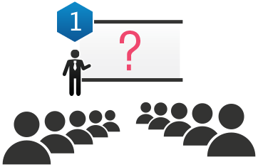
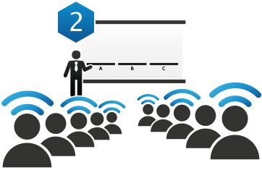
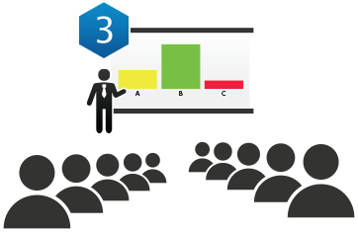
A Voting system for assessment and evaluation
Images courtesy: iclicker.com

Slide 28
How to use this voting system
Usage
Instructor poses multiple-choice questions (verbally or on display)
Students click their choice using remote hand-held transmitters
The system instantly collects and tabulates the responses, which can be viewed & displayed by the instructor
Possible ways of using the system:
Questions can be posed at several points during the class – to check whether the students are following the lecture
Questions can be posed before a lecture begins – short quiz for reading assignments, understanding of previous lecture, etc.
Student responses can be recorded – continuous evaluation
Advantages of using the system:
Ensures students come prepared to class
Keeps students focused on the lecture

Slide 29
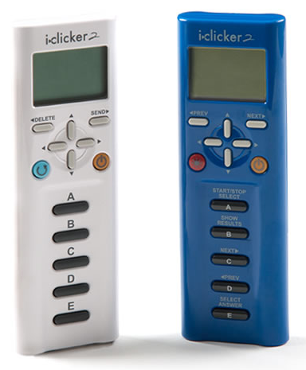
A Voting system for assessment and evaluation
Clickers
iVoter
Disclaimer: The following images are used for illustration alone with no commercial interests to the author. There could be many other solutions available in the market suited to your needs. Images courtesy of iClickers and iVoter.

Slide 30
Example
What are the eigenvalues of the following matrix:
$$A=\left({4 \atop 6}{1 \atop 3}\right)$$
(a) 4,3 | (b) 6,1
(c) 3,2 | (d) 3,3

Slide 31
More examples
Approximately 92% of the volume of an ice cube is submerged when floating. What is the density of ice, in kg/m³ ? (Density of water is 1000 kg/m³ )
  80
  500
  920
  1110
  None of the above

Slide 32
Mind map
Diagram used to visually organize information
Drawn around a single concept, a word/image, and associated ideas are also represented by words/images
Major ideas are directly connected to the central concept and other ideas branch out
Different from Concept Maps where the relationships are shown on the arrows connecting the words/images

Slide 33
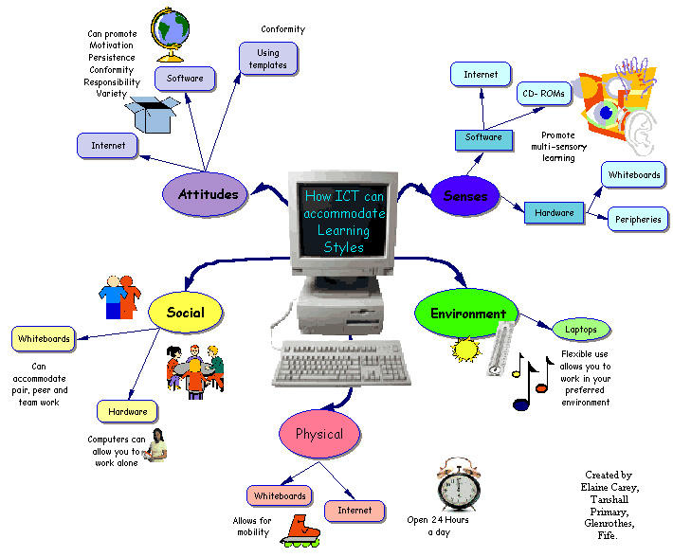
EXAMPLES
Courtesy: www

Slide 34
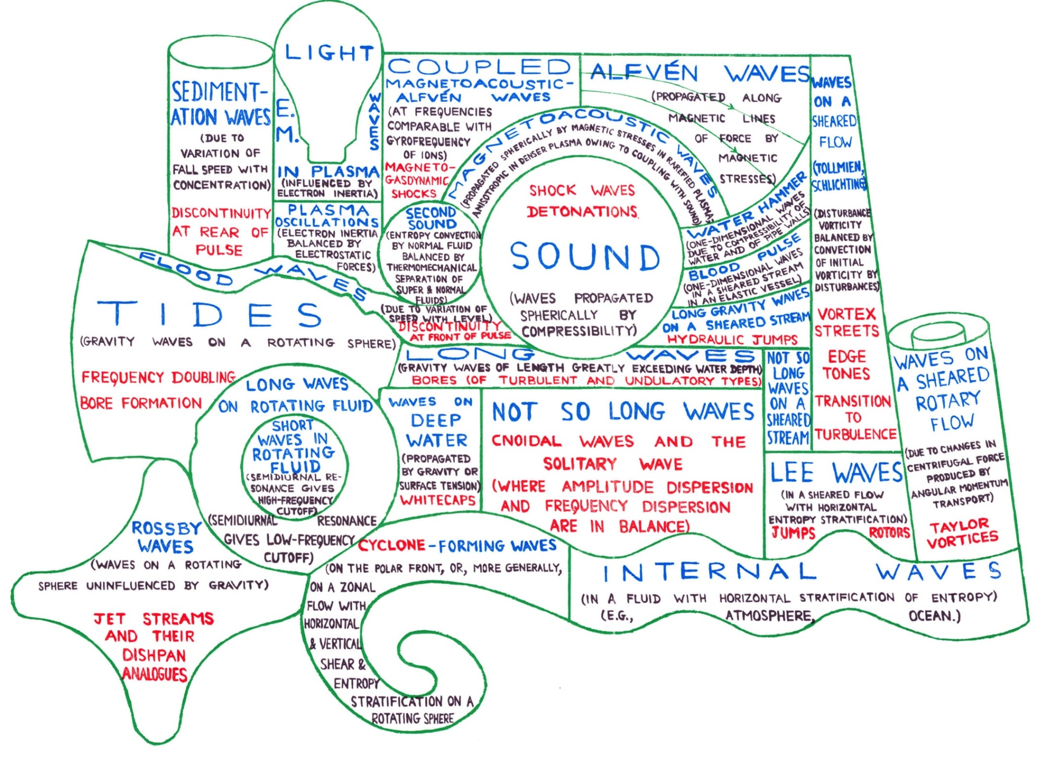
Other examples
Drawing by Sir James Lighthill

Slide 35
Using toys and models
Many toys have an educational value
Using toys in a classroom can be FUN and engaging
Challenges:
  Choosing the right toy
  Additional load on the instructor
  Cost
When toys or models are difficult to construct, we can take help of computer softwares

Slide 36
Evaluation strategies
How does it help an instructor?
How does it help a student?

Slide 37
Continuous evaluation
Weekly quizzes, surprise quizzes to understand students’ comprehension of the material
Regular assignments punctuated by tutorial sessions
Voting process before the lecture
Reduces pressure during/before final examinations
Replace marks with grades – with appropriate weightage in the final course grade

Slide 38
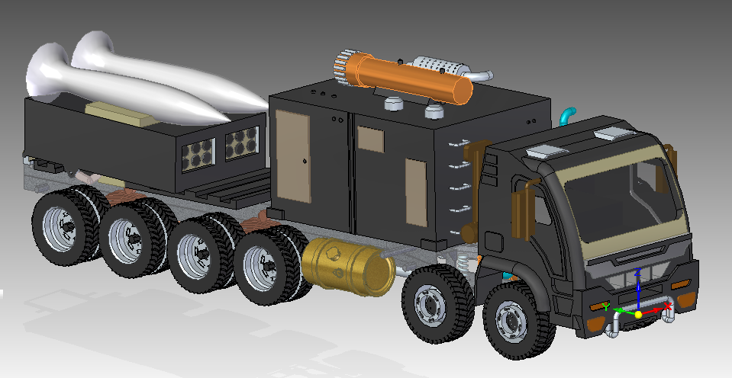
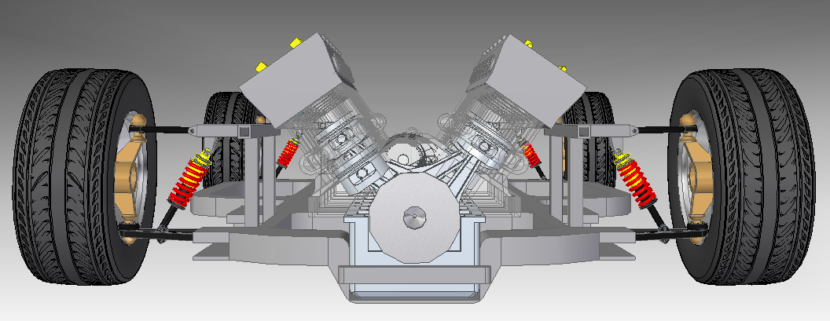
Course projects
Vehicle Dynamics course by Dr. Ashok Kumar Pandey
Solid Modeling of Vehicles
BTech Students, MAE Dept, 2011
Suspension Dynamics
Priyank Prakash, MTech Student, 2014

Slide 39
Student presentations
Hearing one’s own voice
Grading for content and presentation
  Peers can participate in the grading
Choose topics
Quiz and exams on presentations
Sharing PPTs with the class
Seminar style for PG courses
Courtesy: Dr. Haripriya Narasimhan, LA Dept.
Notes:
For advanced UG courses, students can be given projects
For PG courses, term papers can also be given

Slide 40
Learning to teach well
Good teaching doesn’t come naturally
It requires training and practice
Most advanced universities have a strong teacher training program
  MIT Teaching and Learning Laboratory
  Derek Bok Center for Teaching and Learning – Harvard
  Harvard Initiative for Learning and Teaching
  Center for Teaching and Learning – UC Berkeley
  Center for Teaching and Learning – UBC
  Center for Teaching and Learning – Toronto
  Teaching and Learning Center – Tokyo
Notes:
We have a National Mission on Education, TEQIP,

Slide 41

Developing good instructional skills
Total Time
55 minutes
Set up learning environment
13-15 minutes
Set up learning environment
5-10 minutes
Written feedback
5-7 minutes
Mini lesson
25-30 minutes
Based on Instructional Skills Workshop Handbook

Slide 42
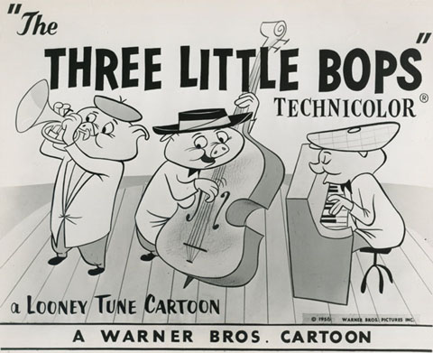
The BOPPPS approach

Slide 43
The BOPPPS approach
Bridge-in
  Explains the value of the lesson to the learner; provides motivation
Objective
  What must the learner do? Under what conditions? How well?
Pre-assess
  Identifies any prior knowledge and whether or not the learner can already accomplish the objective
Participatory Learning
  The learner is as actively involved in the learning process as possible
Post-assess
  Determines if the learner has indeed learned
Summary
  Provides closure and/or follow-up activity to the learner

Slide 44
Thank you
Questions?

